Slide 1
Climate Change
Presented by:
Shilpa, Carmen, Mingma, Aleksandra, Katarzyna, Lei

Slide 2

Agenda
01
Problem Statement
02
Important Factors
03
Data Analysis
04
Graphs & Models
05
Prediction

Slide 3
Problem Statement

Slide 4
Problem Statement
What are the key influencing factors of climate change in the United States? Does Carbon emission, increase in population, energy consumption and meat consumption have any correlation to climate change?
Meat Consumption
Population Increase
CO2 Emission
Energy Consumption
...and more

Slide 5
Possible Variables to Consider
Petroleum Consumption
Coal Emission
Deforestation
Population Growth
Fertilizer Use
Arctic Ice
Meat Consumption
Fossil Fuels
Greenhouse Emission
Daily Temperatures
Snowfall
Precipitation

Slide 6
Important Factors

Slide 7
Three Components
Evidence
Causes
Impact
Supporting data & graphs to show climate change is real
Climate change escalation in recent three decades
Possible correlations to factors like meat consumption, co2 emission, energy consumption, population...and others
Look for anomalies and act upon them
Understanding the factors in order to prevent them

Slide 8
Data Analysis

Slide 9
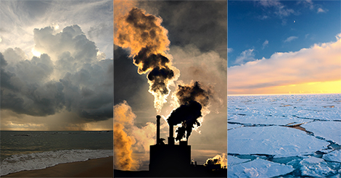
What is the evidence for
the climate change?
Evidence

Slide 10
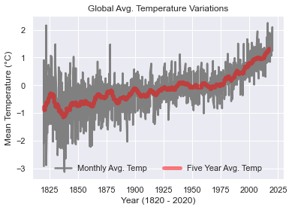
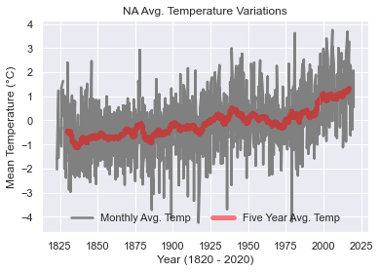
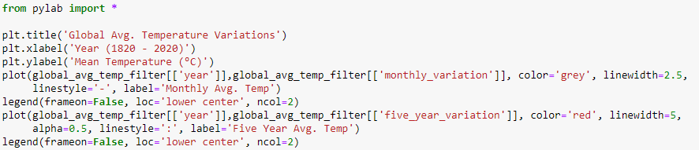
Climate Change is Real
Notes:
Mean Temperature: Estimated Jan 1951-Dec 1980 absolute temperature (C): 8.61
# Estimated Jan 1951-Dec 1980 monthly absolute temperature (C):
# Jan Feb Mar Apr May Jun Jul Aug Sep Oct Nov Dec
# 2.61 3.22 5.30 8.30 11.30 13.44 14.31 13.84 12.05 9.21 6.07 3.64

Slide 11
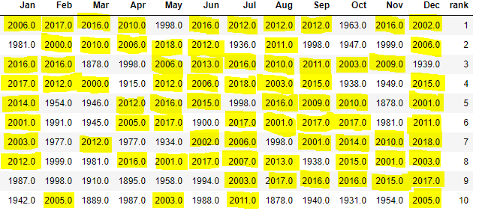
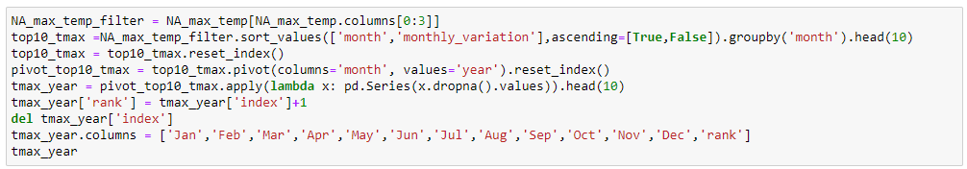
Climate Change is Real
Hottest Years in Each Month Ranked From Top to Bottom (1820 to 2020)

Slide 12
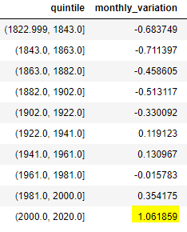
Climate Change is Real
Change in Average Temperature in ºC (1820 to 2020)
vs Mean Temperature between 1951 to 1980

Slide 13
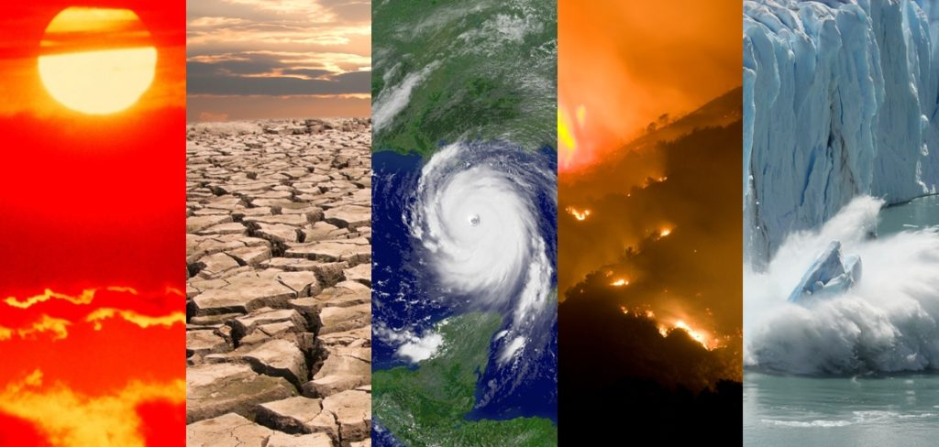
What is the
impact of
the climate change?
1-degree centigrade change means –
Heat Waves increase by 14%
61M people impacted by draught
187M-270M impacted by water scarcity
Extreme precipitation
Impact

Slide 14
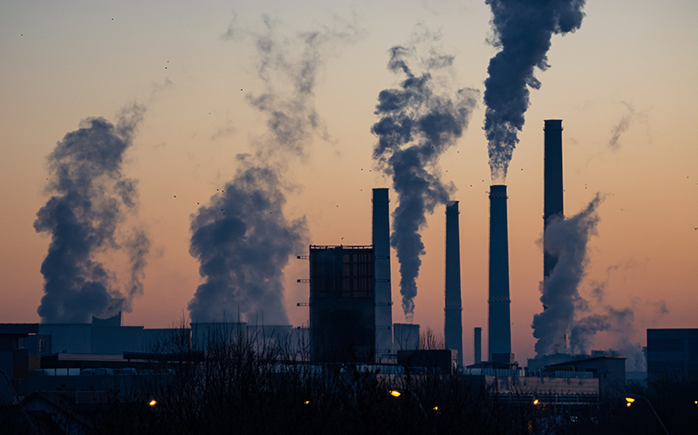
What are the
factors influencing
the climate change?
Causes

Slide 15
Methodology
Collected climate change evidence variables such as maximum temperature, minimum temperature, average temperature, precipitation and snowfall at daily level from 1990 – 2020 for each state in United States
Performed K-means cluster analysis to create 4 meaningful segments such as –
Wet States
Global Warming States
Cold but Dry States
Unpredictable Weather States
Collected climate change influencing variables such as Co2 emission, Petroleum carbon emission, Natural gas carbon emission, Electricity carbon emission, Coal emission, Population, Natural gas consumption, Petroleum consumption, Coal consumption and Meat consumption from 1990 to 2020 (subject to availability) at a yearly level
Performed log-log linear regression model for each of the segments (that is 4 statistical models total) obtained from clustering analysis to understand the impact of the influencing variables. “Average of maximum temperature reached (TMAX_AVG)” is considered as the dependent variable

Slide 16
Graphs & Models

Slide 17
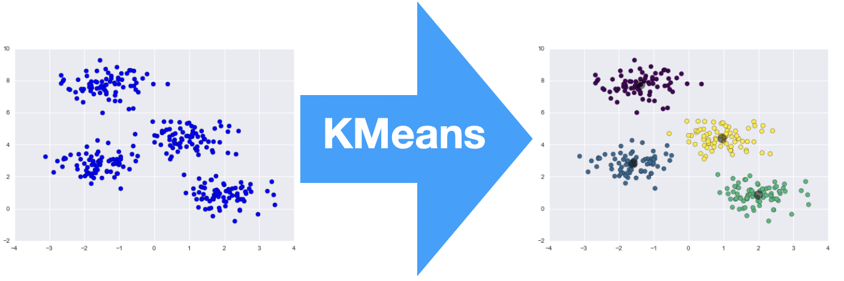
K-Means Clustering

Slide 18
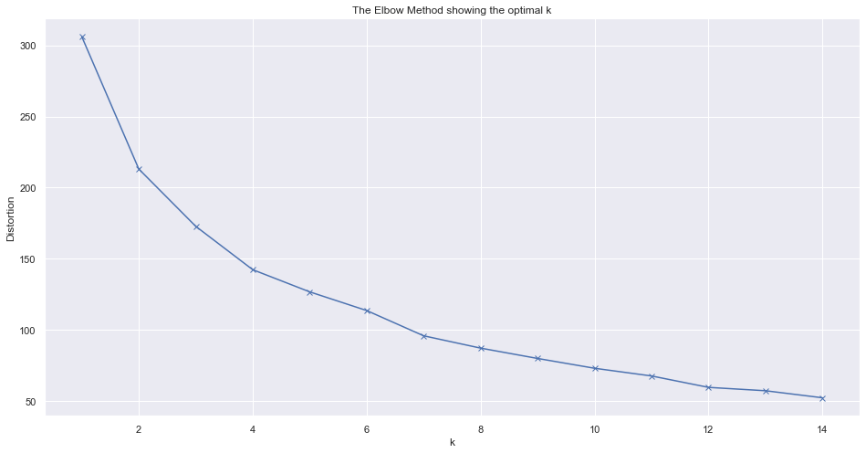
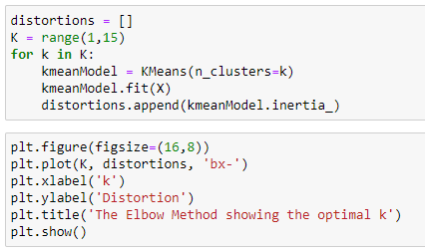
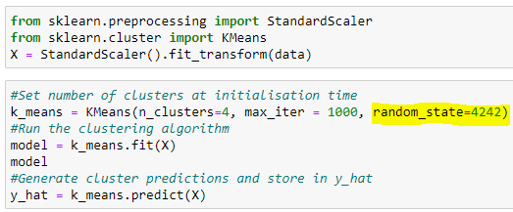
K-Means Clustering Setup
Segmentation Variables
Profiling Variables
Elbow Curve
PRCP_MAX
Maximum precipitation in a year
SNOW_MAX
Maximum snowfall in a year
TAVG_avg_yoy
Average temperature YoY change
(2010-2019 vs 2000-2010)
TMAX_max_yoy
Maximum temperature YoY change
(2010-2019 vs 2000-2010)
TMAX_avg_yoy
Average of maximum temperature YoY change
(2010-2019 vs 2000-2010)
TMIN_min_yoy
Miminim temperature YoY change
(2010-2019 vs 2000-2010)
PRCP_CHG
Maximum precipitation in a year
SNOW_CHG
Maximum snowfall in a year
TMAX_CHG
Average temperature YoY change
(2010-2019 vs 2000-2010)
PRCP_CNT
Maximum temperature YoY change
(2010-2019 vs 2000-2010)
SNOW_CNT
Average of maximum temperature YoY change
(2010-2019 vs 2000-2010)
Overall, 50+ variables to profile the clusters
Elbow method
K-Means Clustering
To reproduce same result again

Slide 19

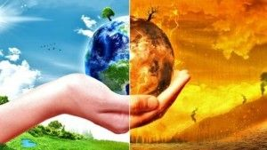
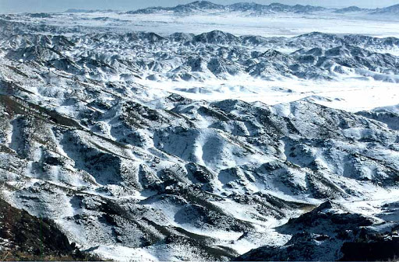
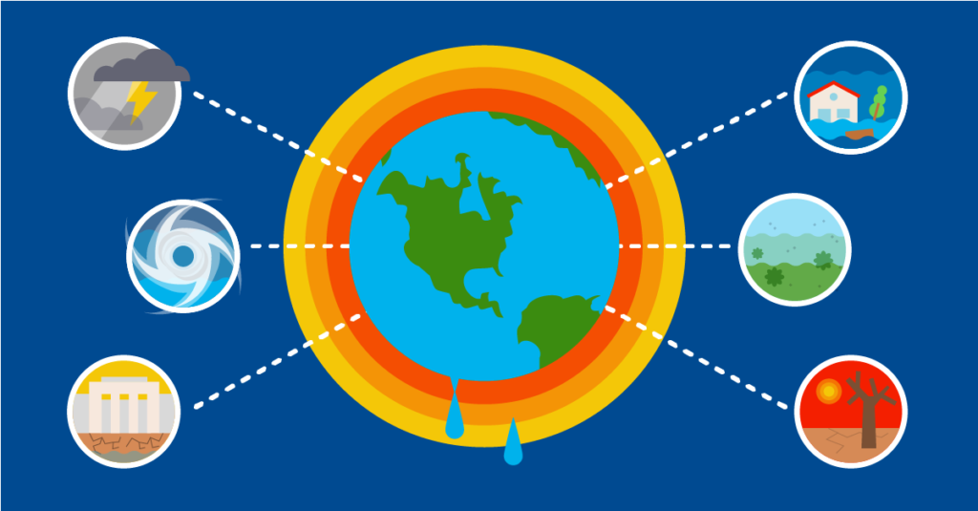
K-Means Insights
WET STATES
GLOBAL WARMING STATES
High rainfall in recent decade than before, change of 270 mm on average. Maximum temperatures increased by 0.82 degree centigrade. States are New Jersey, New York, Connecticut,
Massachusetts, Maryland and other 6 states
Snow days and quantity is reduced, and more precipitation was observed in the recent decade compared to previous. Minimum temperature went up 0.2-degree centigrade. The states are California, Alaska, Nevada, Michigan,
Oregon, Wisconsin, South Dakota and 8 other states
COLD BUT DRY STATES
UNPREDICTABLE WEATHER STATES
Average, minimum and maximum temperatures have gone down by 0.4 degree centigrade. Number of days with precipitation or snow went down. The states are Arizona, New Mexico and Colorado
Maximum temperature increased by 0.8-degree centigrade and fluctuated by 2.9-degree centigrade over the last decade. Heavy snow and precipitation concentrated over a brief period and overall increase in average temperature. The states are Florida, Texas, Illinois, Kansas, Ohio,
Tennessee, Virginia, Los Angeles and 14 other states

Slide 20
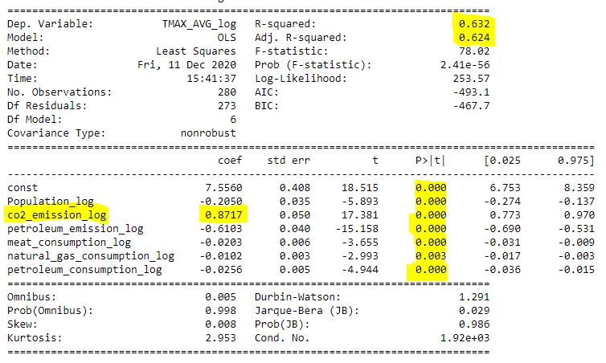
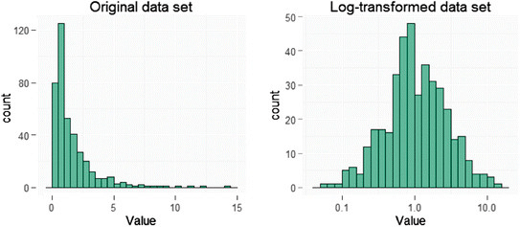
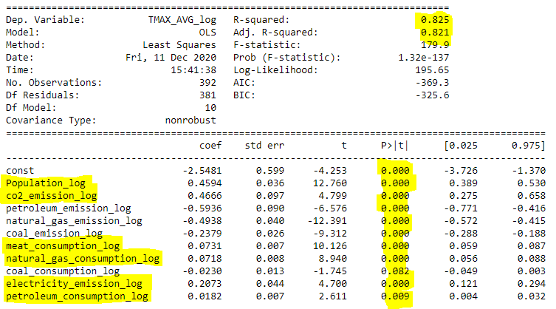
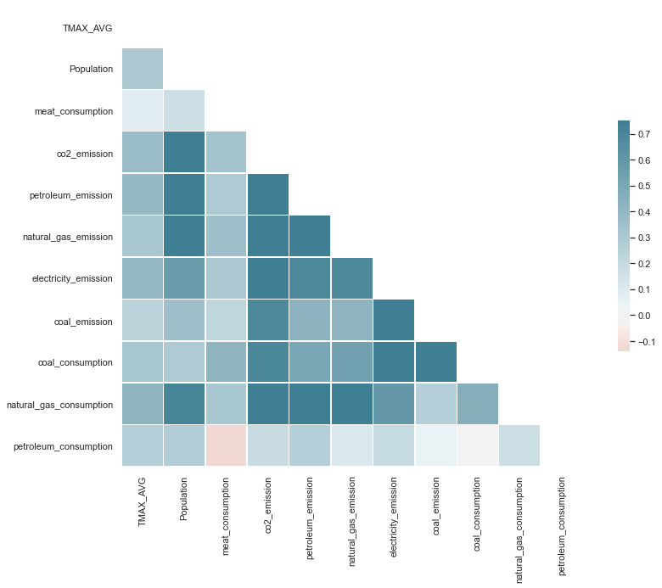
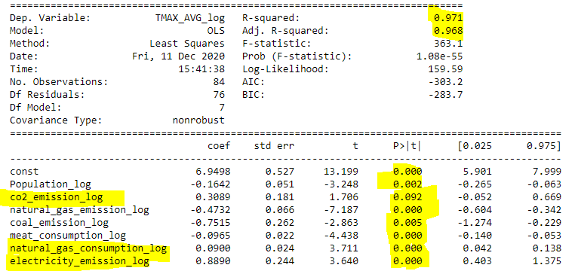
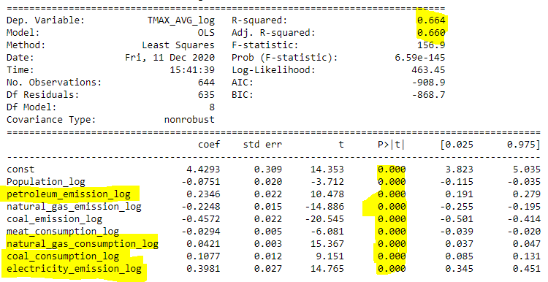
Statistical Model
Log transformation
1
2
Correlation Matrix
3
4

Slide 21
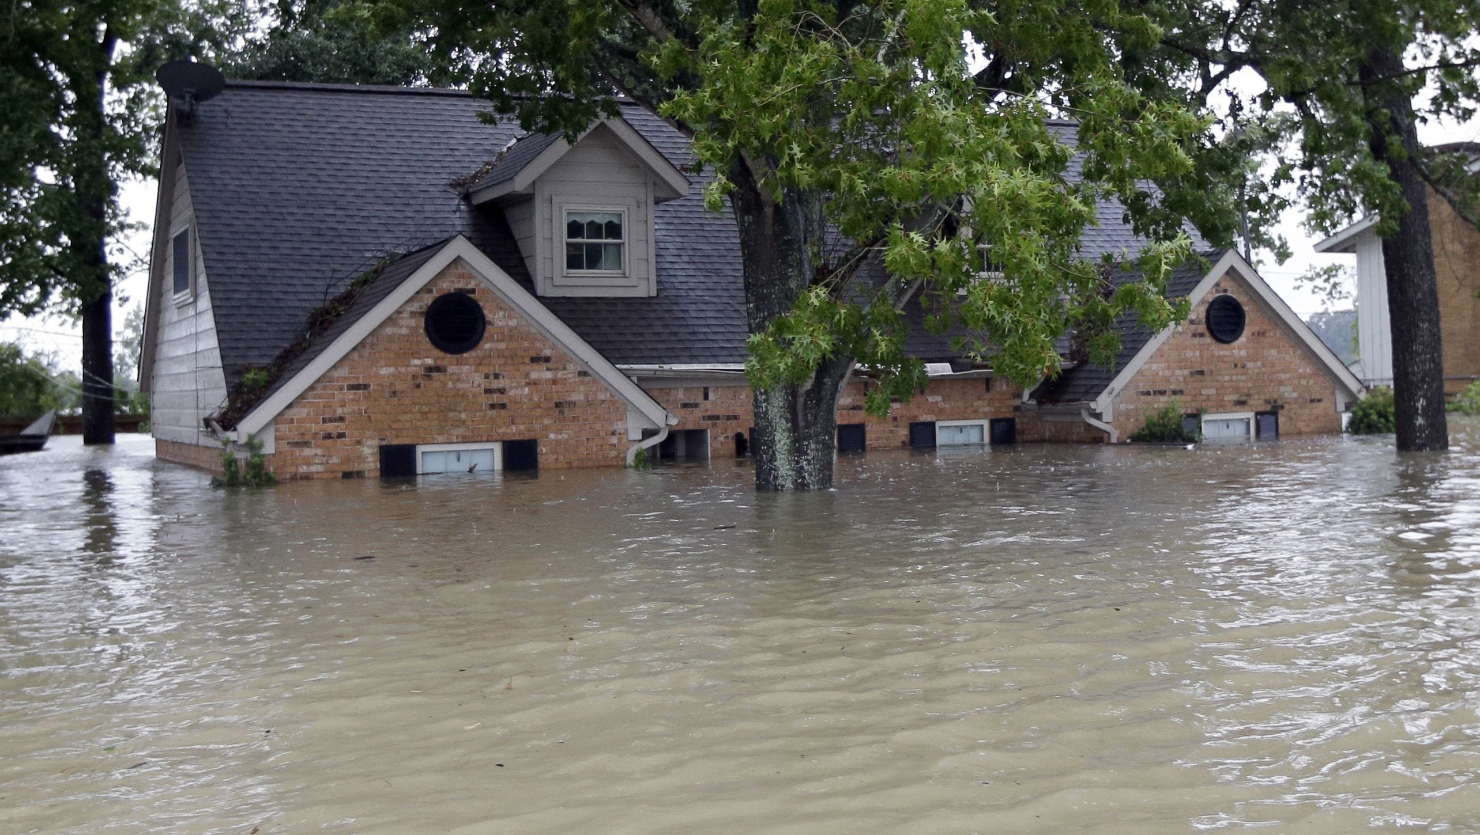
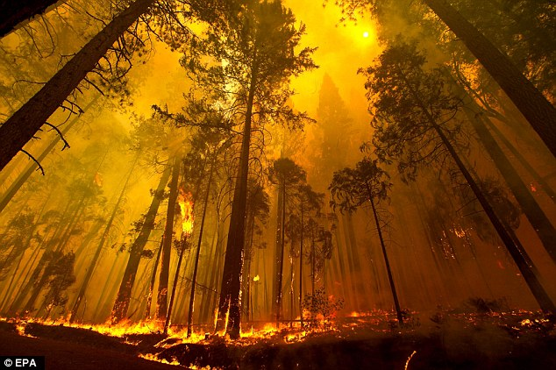
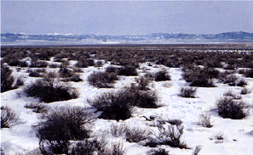

Statistical Model Results
WET STATES
GLOBAL WARMING STATES
COLD & DRY STATES
UNPREDICTABLE WEATHER
STATES
New Jersey, New York, Connecticut,
Massachusetts, Maryland ….
California, Alaska, Nevada, Michigan,
Oregon, Wisconsin, South Dakota….
Arizona, New Mexico and Colorado
Florida, Texas, Illinois, Kansas, Ohio,
Tennessee, Virginia, Los Angeles….
CO2 Emission 61%
Population 59%
CO2 Emission 16%
Natural Gas Consumption 10%
Meat Consumption 9%
Electricity Emission 5%
Petroleum Consumption 2%
Electricity Emission 53%
CO2 emission 22%
Natural Gas Consumption 25%
Coal Consumption 35%
Electricity Emission 32%
Petroleum Emission 18%
Natural Gas Consumption 14%

Slide 22
Prediction

Slide 23
Thank You

